Slide 1
Emergent Behaviours Demonstrated by Immune System and Neuroblastoma
20/03/2020
Dr Kenneth Y. Wertheim
Research Associate
Department of Computer Science and Insigneo Institute for in silico Medicine, University of Sheffield

Slide 2
Introduction

Slide 3
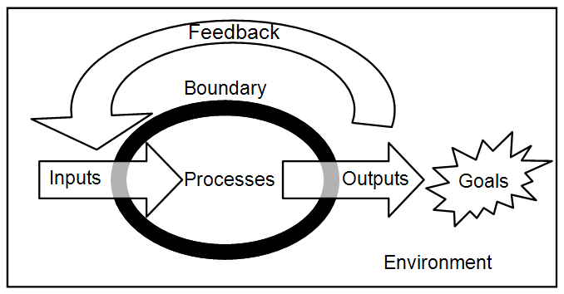
Systems theory.
Defining features of a system:
Boundary with an environment.
Components interacting with each other.
What makes a system complex?
Its properties and behaviours cannot be predicted from those of its components in isolation.
https://careersintheory.files.wordpress.com/2011/05/opensystem.png
Emergence is the phenomenon of a system acquiring properties or behaviours that its components do not have.

Slide 4
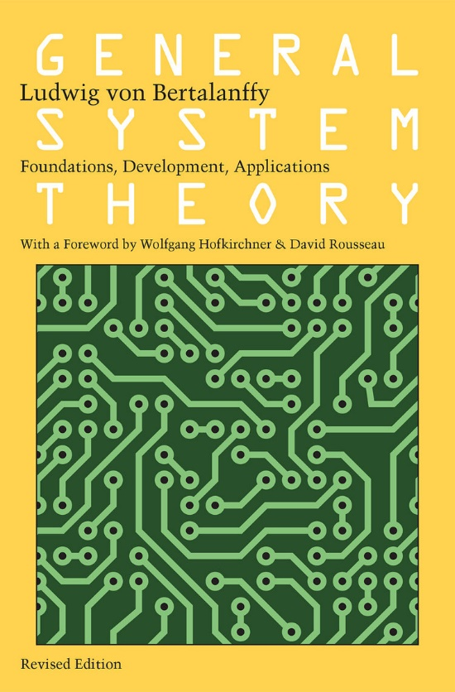
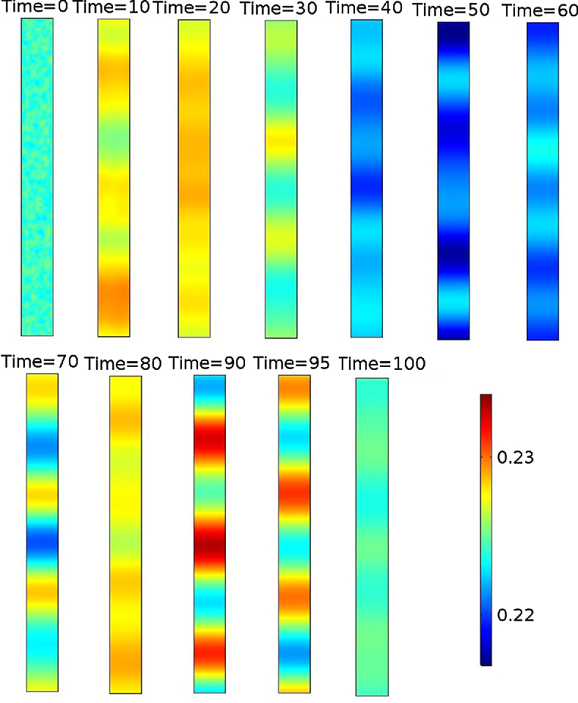
Systems theory.
Major types of emergent behaviours:
Self-organisation.
Adaptation.
Non-linear response.
Unplanned order characterised by entropy decrease.
Turing patterns emerge spontaneously from noises in an otherwise homogeneous medium.
Wertheim, Kenneth Y., and Tiina Roose. "Can VEGFC Form Turing Patterns in the Zebrafish Embryo?." Bulletin of mathematical biology 81.4 (2019): 1201-1237.

Slide 5
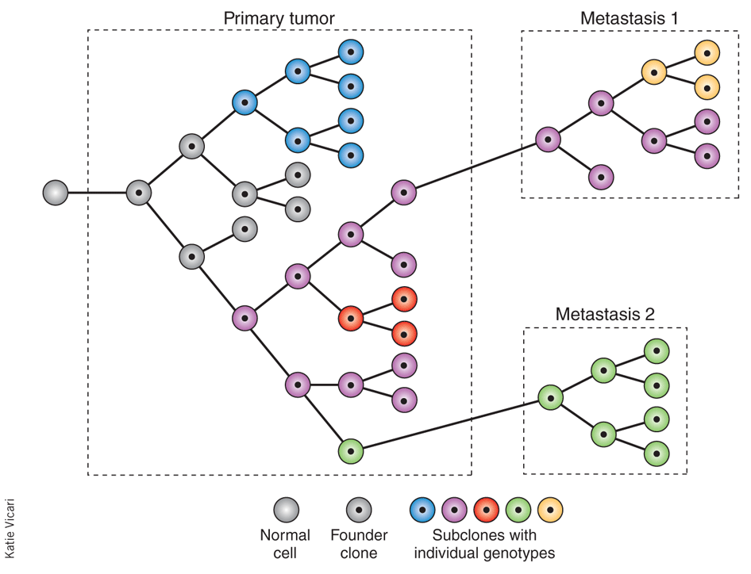
Systems theory.
Major types of emergent behaviours:
Self-organisation.
Adaptation.
Non-linear response.
Systemic resilience in the face of environmental inputs, often achieved by mutating and evolving parts.
Drug-sensitive cancer cells die so that drug-resistant cells can proliferate.
Caldas, Carlos. "Cancer sequencing unravels clonal evolution." Nature biotechnology 30.5 (2012): 408.

Slide 6

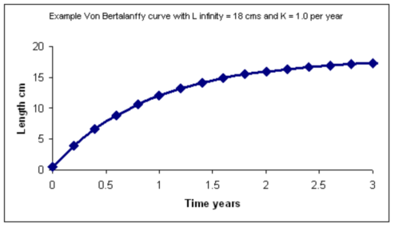
Systems theory.
Major types of emergent behaviours:
Self-organisation.
Adaptation.
Non-linear response.
Systemic outputs are not proportional to environmental inputs.
Law of diminishing returns.
Von Bertalanffy function is a growth model linking mean length to age in animals.
http://www.pisces-conservation.com/growthhelp/index.html?von_bertalanffy.htm

Slide 7
Immunology

Slide 8
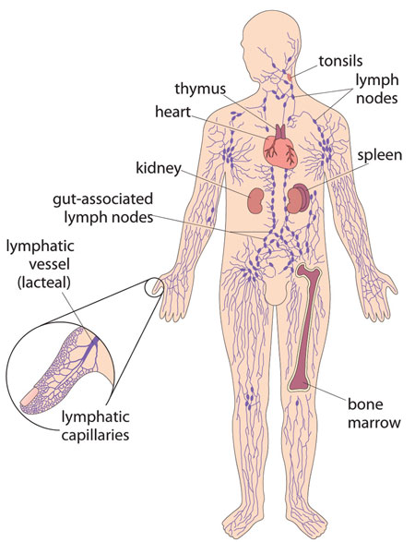
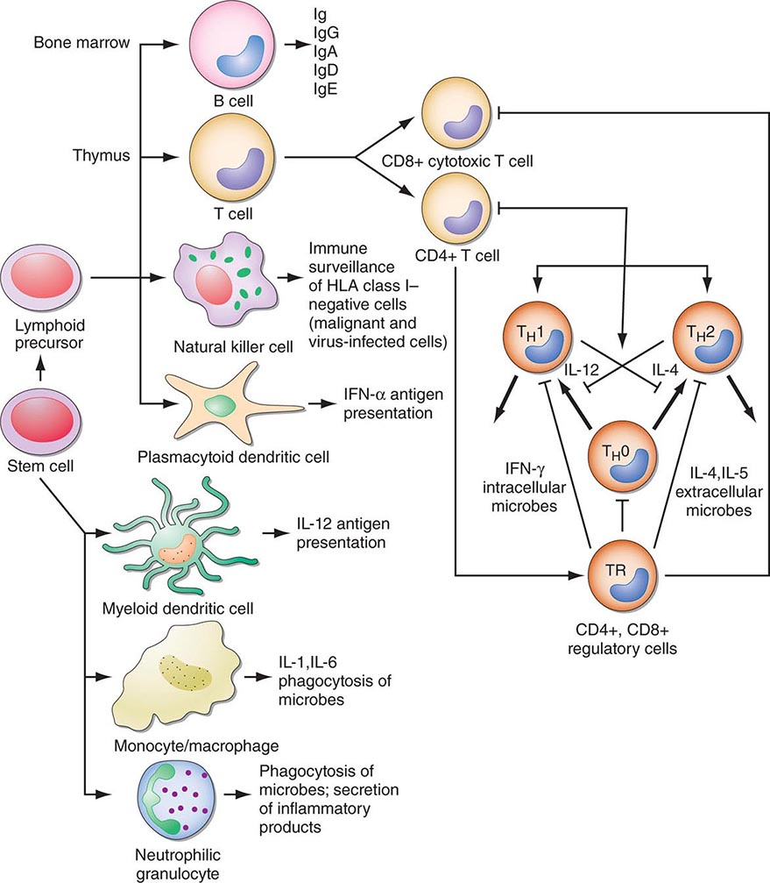
The immune system.
Multi-scale problem:
Movement of cells and cytokines at the systemic scale.
Non-linear life cycle at the cellular scale.
Intracellular signal transduction, gene regulation, and metabolism at the molecular scale.
Multi-approach solution:
Dynamics between these layers of organisation.
Spatially distributed.
Multiple length and time scales.
The Open University, SXR376 Preparatory Reading, fig. 1.2, page 7. http://moodle.digital-campus.org/mod/page/view.php?id=18790.
https://clinicalgate.com/introduction-to-the-immune-system-2/#ch372efig2.
Many tissues and organs.
>10 immune cell types communicating via dozens of cytokines and other signalling molecules.

Slide 9
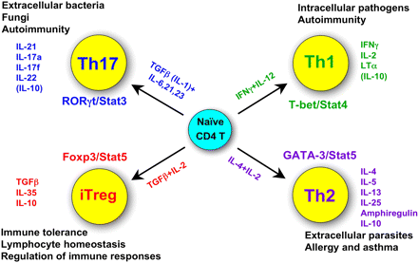
CD4+ T lymphocytes.
Functions:
Central to adaptive immunity.
Antigen-specific, slow-forming, and long-lasting.
Secrete cytokines to unleash other immune cell types, e.g., CD8+ T cells, macrophages, etc.
Aka T helper cells.
Life cycle:
Recognise an antigen.
Migrate.
Proliferate.
Differentiate.
Secrete cytokines.
Death or memory formation.
Zhu, J. and Paul, W. E. (2008). CD4 T cells: fates, functions, and faults. Blood, 112(5), 1557-1569. https://doi.org/10.1182/blood-2008-05-078154.

Slide 10
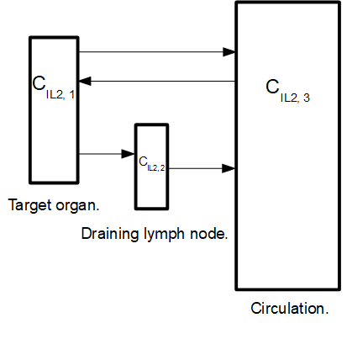
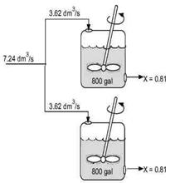
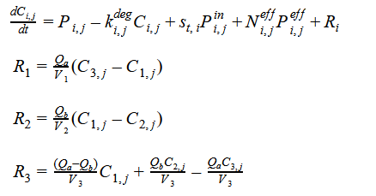
Systemic scale.
Compartmental ordinary differential equations:
Three compartments.
11 cytokines (IL2, IL4, IL6, IL12, IL17, IL18, IL21, IL23, IL27, IFNg, and TGFb).
Molecular copy number >>>>> cell copy number.
Three spatially lumped concentrations per cytokine.
Three continuous stirred-tank reactors.
Natural production and degradation.
Convective transport between the compartments.
Production due to inflammation (linked to cells).
Properties:
Linear terms, e.g., IL2 does not react with IL4.
Coupled through the transport terms.
Fogler, H. S. (2010). Essentials of chemical reaction engineering solution manual. Pearson Education. https://www.chegg.com/homework-help/asked-explore-example-problems-chapter-learn-effects-varyin-chapter-5-problem-2qp-solution-9786612872860-exc.

Slide 11
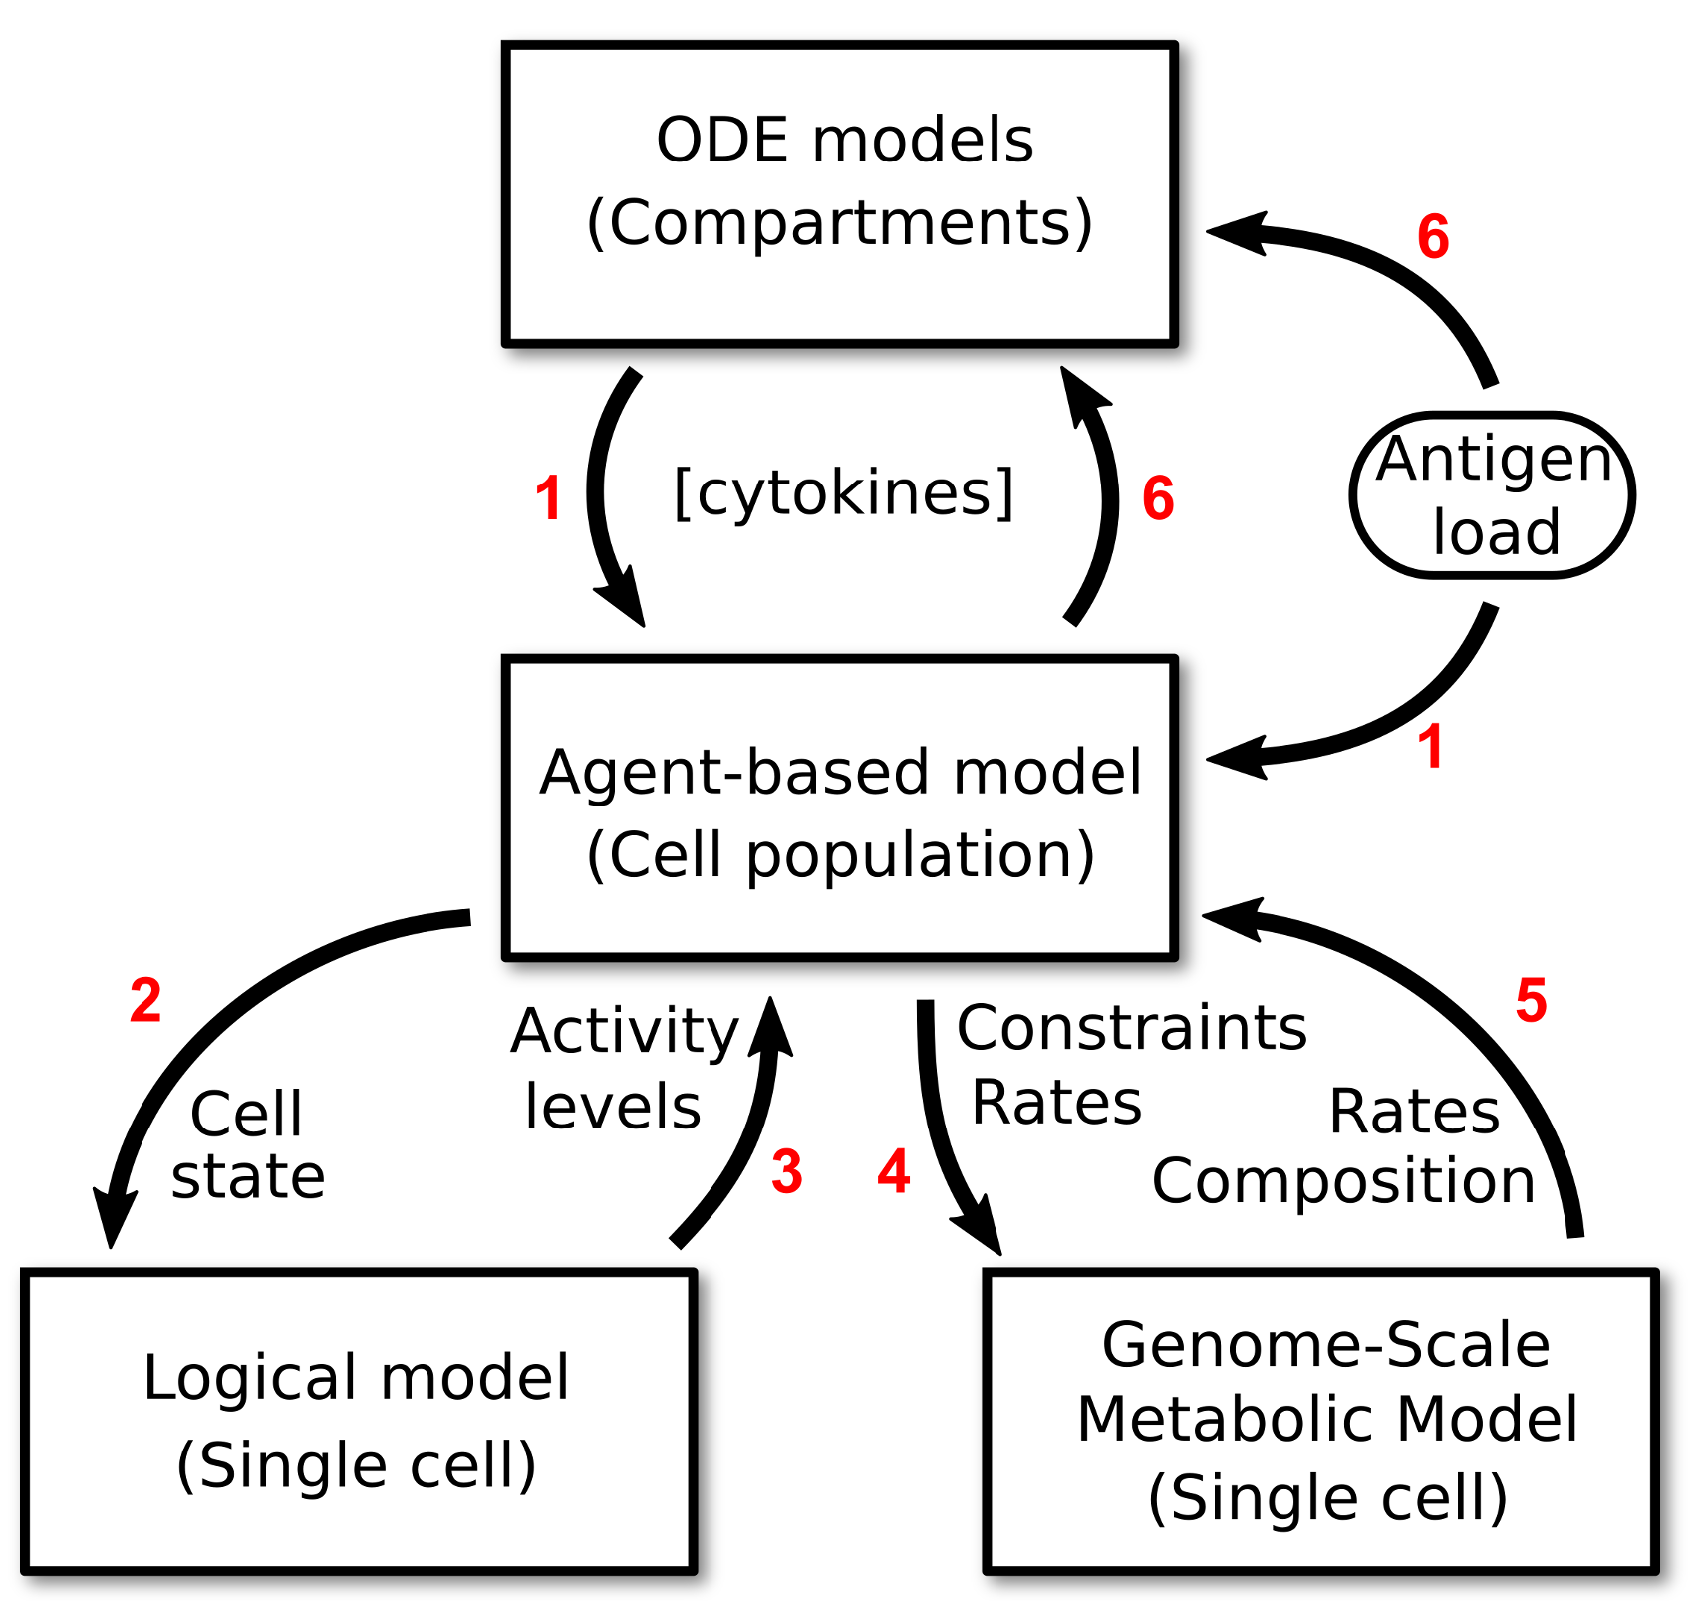
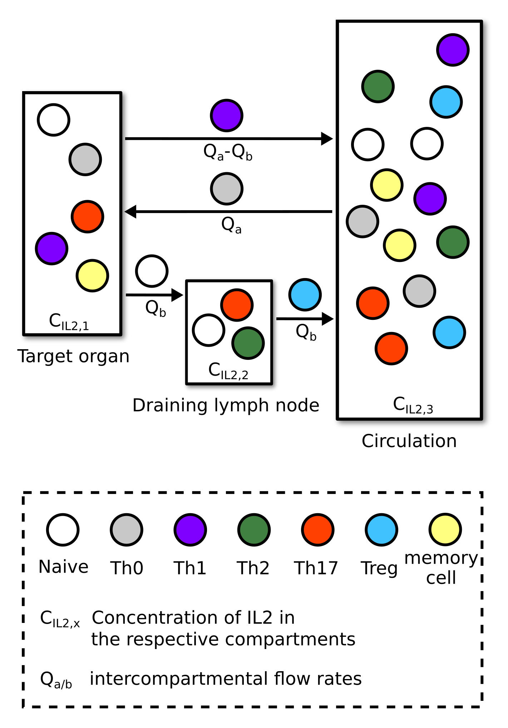
Cellular scale.
Agent-based model:
Heterogeneity and stochastic effects.
Representative population in each compartment.
Life cycle as state transitions:
Antigen activates naïve cells.
Effector cells migrate between compartments.
Cytokines differentiate proliferating effector cells.
Different phenotypes secrete different cytokines.
Withdrawal of antigen leads to cell death or transition to memory cells.
Properties:
Antigen and other immune cells abstracted into an input.
Intracellular models used to calculate state transition probabilities.
Agents collectively modify the systemic scale (compartmental ODEs).

Slide 12
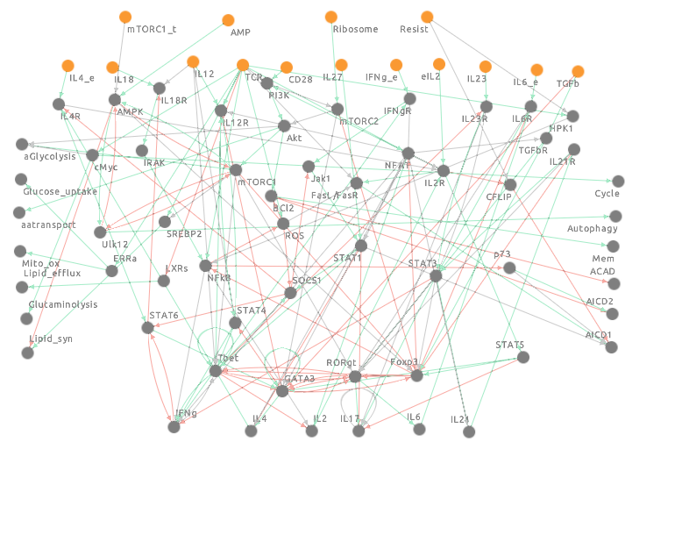
Molecular scale.
Logical model (Boolean network):
Each node is a Boolean variable (0 or 1).
Signal transduction and gene regulation events.
Yellow input nodes, stochastically on/off.
Grey output nodes, determined by the states of all nodes, give state transition probabilities.
Markov chain:
Stochastically fix the input node values.
Synchronously update the output nodes.
Iterate 1 and 2 until convergence to an estimated attractor (Kolmogorov–Smirnov test).
Sample the estimated attractor.
Fraction of iterations where an output node is on = its activity level in the estimated attractor.
Puniya, B. L., et al. (2018). A mechanistic computational model reveals that plasticity of CD4+ T cell differentiation is a function of cytokine composition and dosage. Frontiers in Physiology, 9, 462.
Helikar, T., et al. (2012). The cell collective: toward an open and collaborative approach to systems biology. BMC systems biology, 6(1), 96.

Slide 13
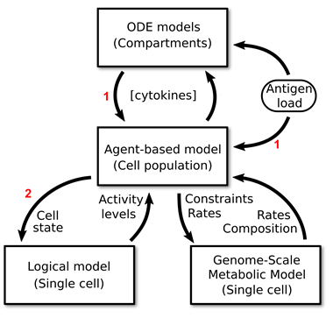
Molecular scale.
Input nodes:
User-defined input representative of antigen and other immune cells.
Compartmental cytokine concentrations.
Agent attributes, e.g., division count.
Puniya, B. L., et al. (2018). A mechanistic computational model reveals that plasticity of CD4+ T cell differentiation is a function of cytokine composition and dosage. Frontiers in Physiology, 9, 462.
Helikar, T., et al. (2012). The cell collective: toward an open and collaborative approach to systems biology. BMC systems biology, 6(1), 96.

Slide 14
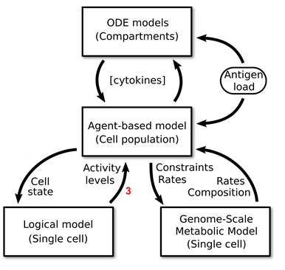
Molecular scale.
State transition probabilities (internal):
Cell cycling (proliferation), apoptosis, and memory formation.
Differentiation (Tbet for Th1, GATA3 for Th2, RORgt for Th17, and Foxp3 for Treg).
Puniya, B. L., et al. (2018). A mechanistic computational model reveals that plasticity of CD4+ T cell differentiation is a function of cytokine composition and dosage. Frontiers in Physiology, 9, 462.
Helikar, T., et al. (2012). The cell collective: toward an open and collaborative approach to systems biology. BMC systems biology, 6(1), 96.

Slide 15
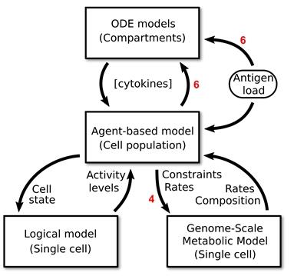
State transition probabilities (external):
Cytokines secreted by the cell.
Parameterise the systemic scale (compartmental ODEs).
Metabolic events such as glucose uptake.
Each metabolic event comprises many metabolic reaction fluxes.
Parameterise another layer at the molecular scale (metabolism).
Molecular scale.
Puniya, B. L., et al. (2018). A mechanistic computational model reveals that plasticity of CD4+ T cell differentiation is a function of cytokine composition and dosage. Frontiers in Physiology, 9, 462.
Helikar, T., et al. (2012). The cell collective: toward an open and collaborative approach to systems biology. BMC systems biology, 6(1), 96.

Slide 16
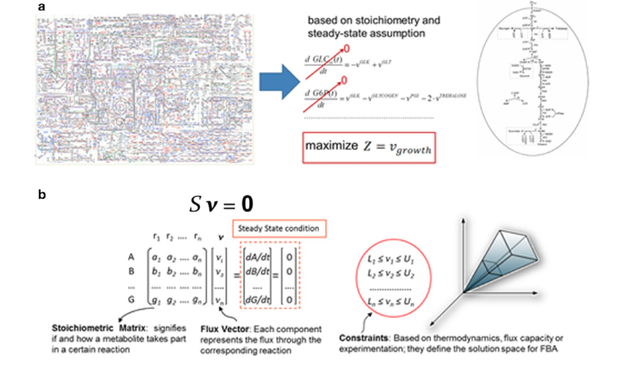
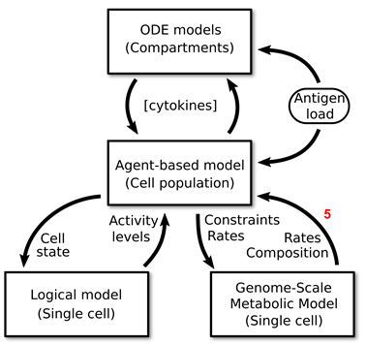
Metabolism as a linear programming problem:
Genome-scale metabolic networks.
Mass balance of each metabolite.
Steady-state assumption.
Objective function (e.g., DNA synthesis rate) in terms of metabolic reaction fluxes.
Constrain the fluxes according to the Boolean network outputs.
Simplex algorithm.
Optimised synthesis rate becomes an agent attribute.
Molecular scale.
Aka flux balance analysis.
Simeonidis, E. and Price, N. D. (2015). Genome-scale modeling for metabolic engineering. Journal of industrial microbiology & biotechnology, 42(3), 327-338. https://link.springer.com/article/10.1007/s10295-014-1576-3.
Five constraint-based genome-scale metabolic models (Lal Puniya et al., 2020), one for Th0, Th1, Th2, Th17, and Treg each. Around 3000 metabolites and 4000 metabolic reaction fluxes per model.

Slide 17
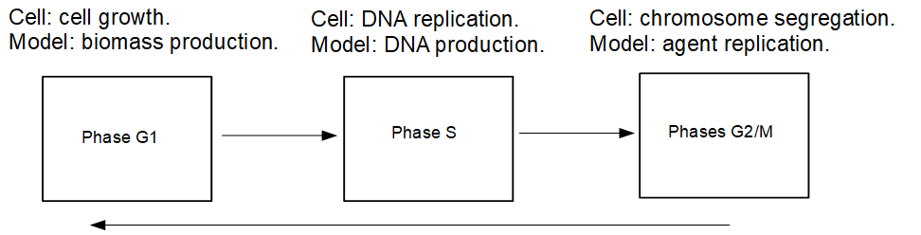
Cellular scale.
A cell undergoes the mammalian cell cycle in order to proliferate.
Progress through a cell cycle phase is tracked by optimising and using the objective function for the phase, e.g., DNA synthesis for phase S.
Decide when a cell should divide.
Not to be confused with the life cycle of CD4+ T cells, of which proliferation is but one step.

Slide 18
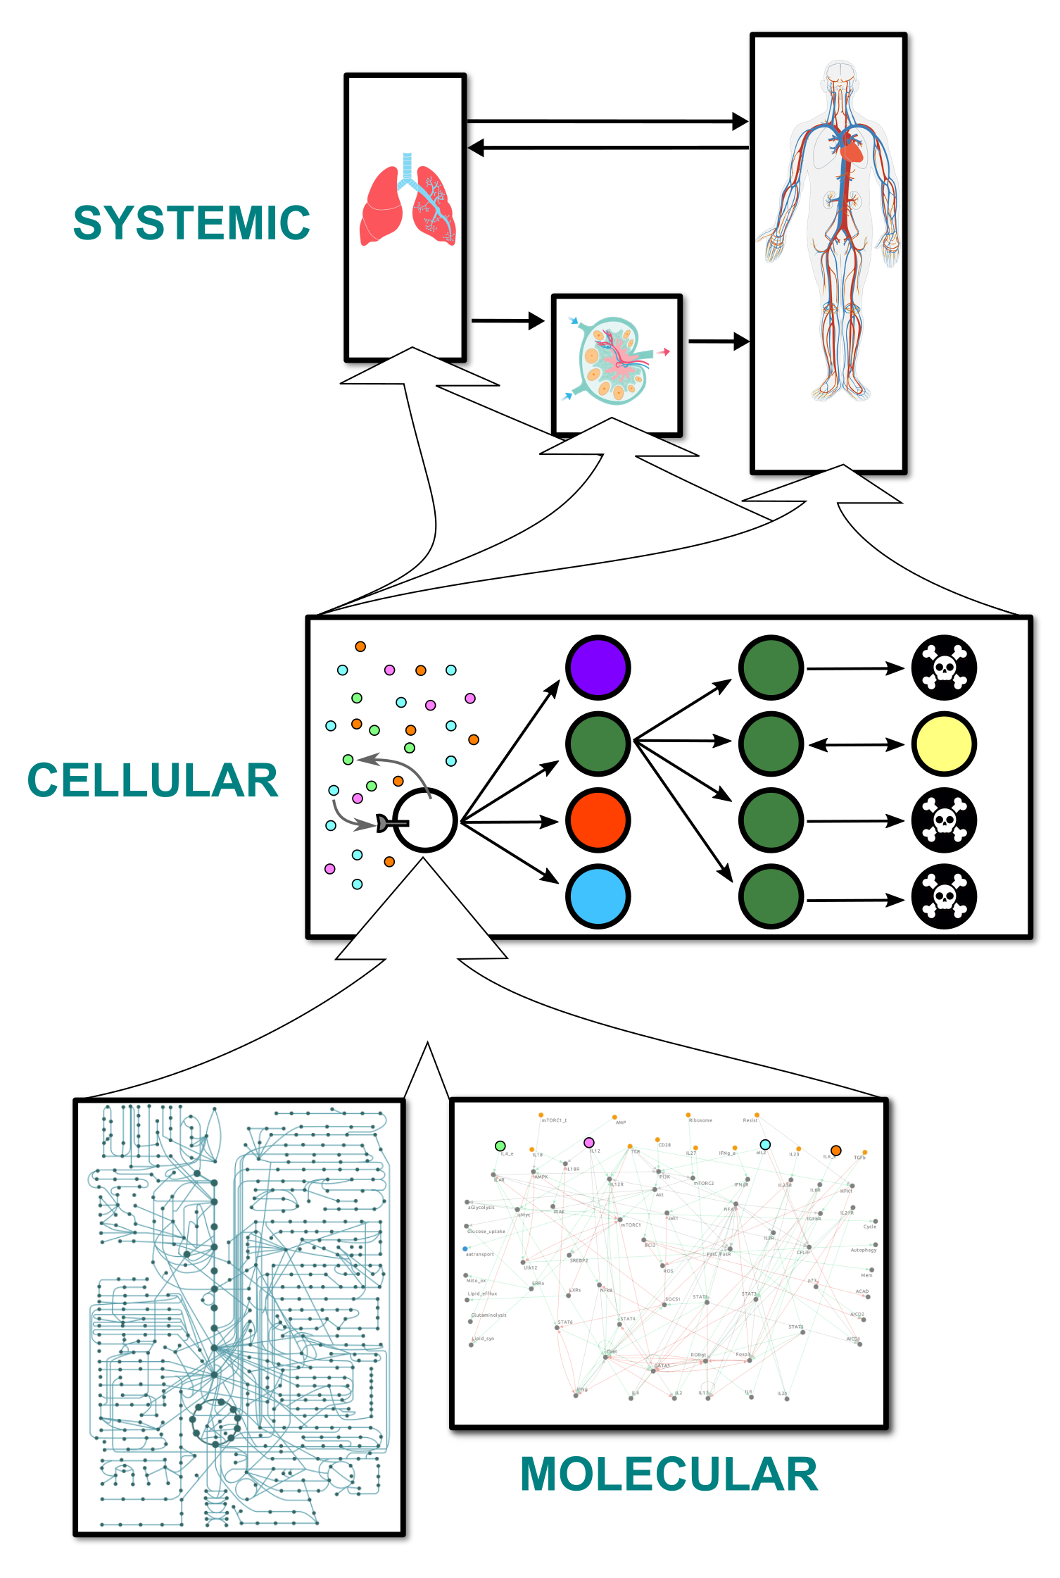
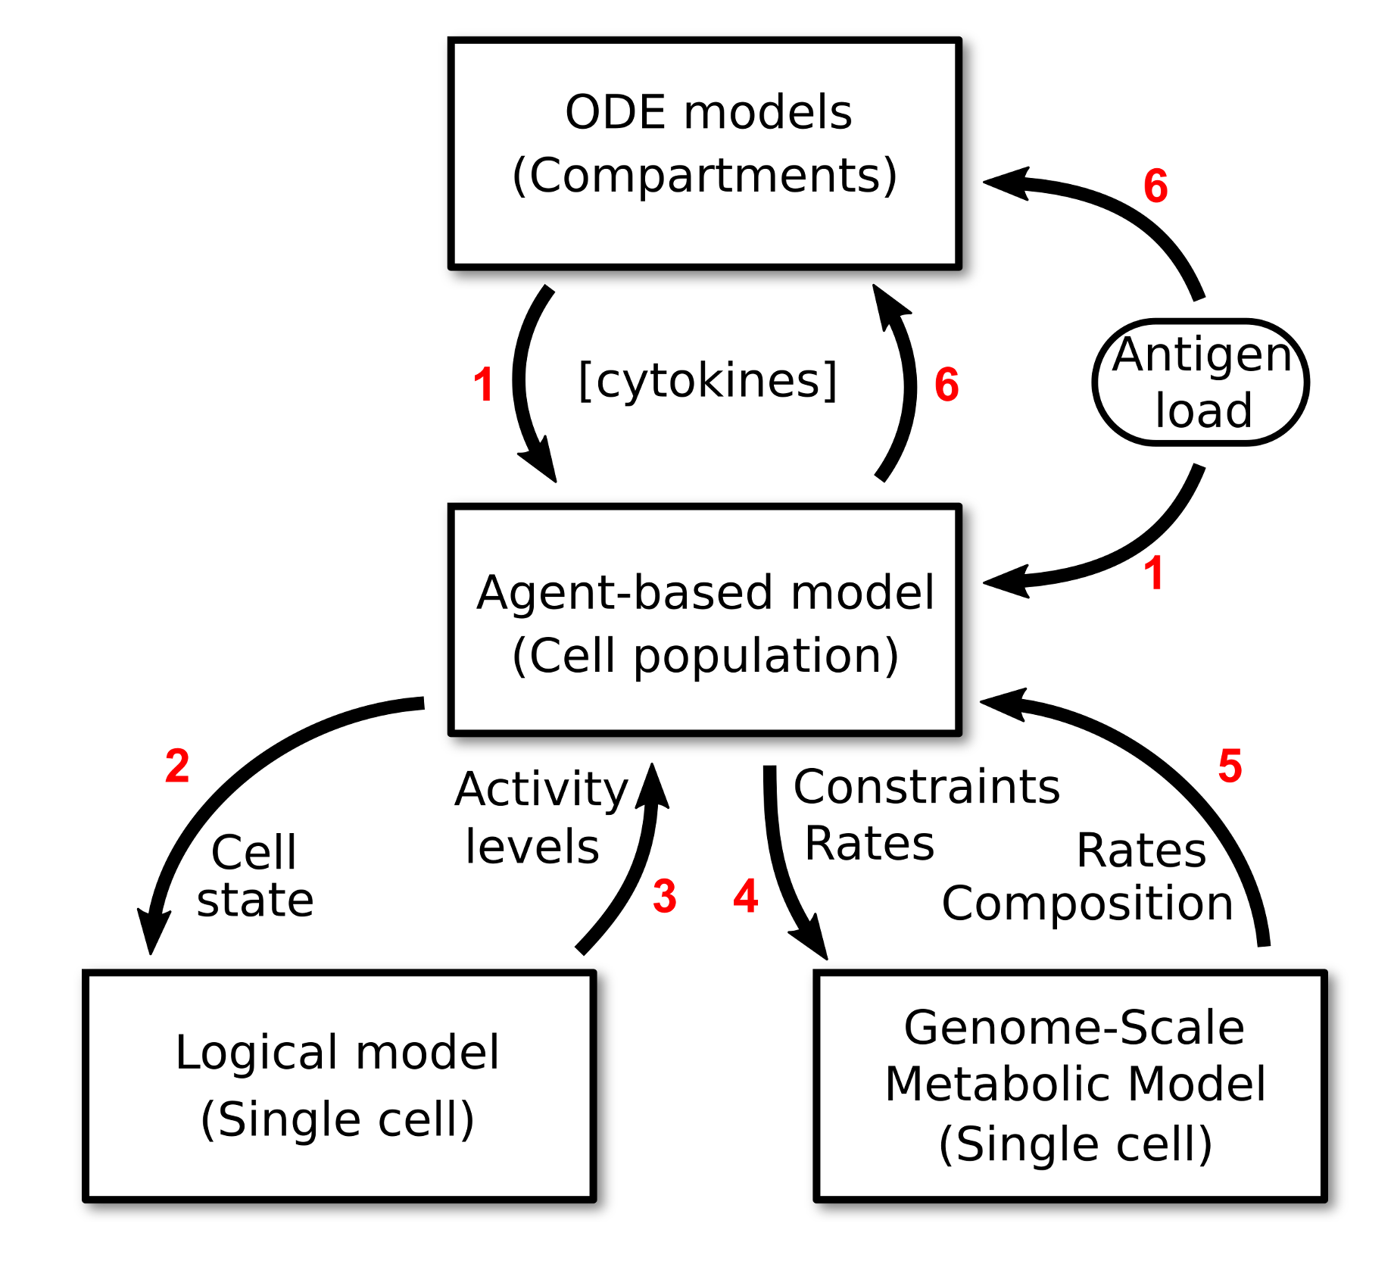
Integrative algorithm.
Monte Carlo simulation.

Slide 19
Integrative algorithm.
Monte Carlo simulation.
Kolmogorov–Smirnov test.

Slide 20
Integrative algorithm.
Monte Carlo simulation.
Kolmogorov–Smirnov test.
Linear programming.

Slide 21
Integrative algorithm.
Finite difference method.
Monte Carlo simulation.
Kolmogorov–Smirnov test.
Linear programming.

Slide 22
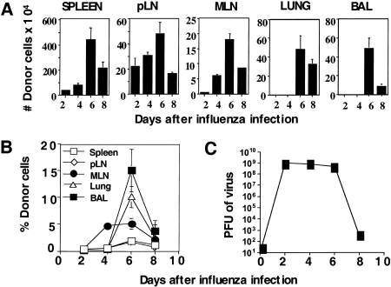
V1: simulating infection.
Román, E., et al. (2002). CD4 effector T cell subsets in the response to influenza: heterogeneity, migration, and function. Journal of Experimental Medicine, 196(7), 957-968.
Experimental study:
Mice were inoculated with Influenza A virus (A/PR/8/34).
Viral load and CD4+ T cell count were quantified in different tissues at different time points.
Lungs, bronchial alveolar lavages, spleens, draining lymph nodes, and non-draining lymph nodes.
Viral load trajectory used as input in simulations.

Slide 23
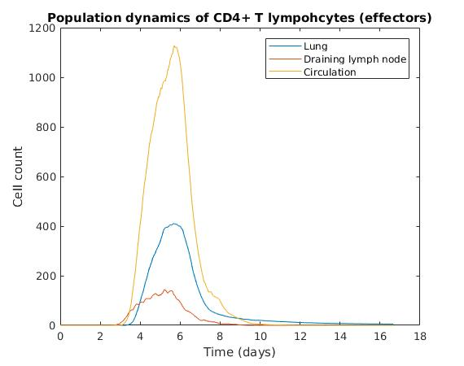
V1: simulating infection.
Román, E., et al. (2002). CD4 effector T cell subsets in the response to influenza: heterogeneity, migration, and function. Journal of Experimental Medicine, 196(7), 957-968.
Average population dynamics of CD4+ T cells in the three compartments.
Experimental study:
Mice were inoculated with Influenza A virus (A/PR/8/34).
Viral load and CD4+ T cell count were quantified in different tissues at different time points.
Lungs, bronchial alveolar lavages, spleens, draining lymph nodes, and non-draining lymph nodes.

Slide 24
V1: simulating infection.
Román, E., et al. (2002). CD4 effector T cell subsets in the response to influenza: heterogeneity, migration, and function. Journal of Experimental Medicine, 196(7), 957-968.
Four days post-infection:
Draining lymph node (red), nine-fold expansion.
Lungs (blue), trajectory is very far from its peak.
Time delay in the lungs was observed experimentally (none in their case).
Experimental study:
Mice were inoculated with Influenza A virus (A/PR/8/34).
Viral load and CD4+ T cell count were quantified in different tissues at different time points.
Lungs, bronchial alveolar lavages, spleens, draining lymph nodes, and non-draining lymph nodes.

Slide 25
V1: simulating infection.
Román, E., et al. (2002). CD4 effector T cell subsets in the response to influenza: heterogeneity, migration, and function. Journal of Experimental Medicine, 196(7), 957-968.
Six days post-infection:
All three trajectories peak.
Agreement with experimental data.
Experimental study:
Mice were inoculated with Influenza A virus (A/PR/8/34).
Viral load and CD4+ T cell count were quantified in different tissues at different time points.
Lungs, bronchial alveolar lavages, spleens, draining lymph nodes, and non-draining lymph nodes.

Slide 26
V1: simulating infection.
Román, E., et al. (2002). CD4 effector T cell subsets in the response to influenza: heterogeneity, migration, and function. Journal of Experimental Medicine, 196(7), 957-968.
Eight days post-infection:
All three trajectories are declining.
Agreement with experimental data.
Experimental study:
Mice were inoculated with Influenza A virus (A/PR/8/34).
Viral load and CD4+ T cell count were quantified in different tissues at different time points.
Lungs, bronchial alveolar lavages, spleens, draining lymph nodes, and non-draining lymph nodes.

Slide 27
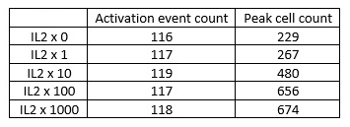
V2: IL2 dose-response study.
Peak responses at different IL2 concentrations.
Effects of IL2 on metabolism:
Repeated the study at different IL2 concentrations.
Found the peak cell count in each case.
Dose-response study.
Three-fold increase in agreement with an experiment (Deenick et al., 2003).

Slide 28

V2: IL2 dose-response study.
Peak responses at different IL2 concentrations.
Decoupled the logical model from the other modules in the framework.
Estimated the attractors corresponding to three IL2 concentrations (input nodes).
IL2 has a positive influence on the metabolic events involved in biomass synthesis.
Effects of IL2 on metabolism:
Repeated the study at different IL2 concentrations.
Found the peak cell count in each case.
Dose-response study.

Slide 29
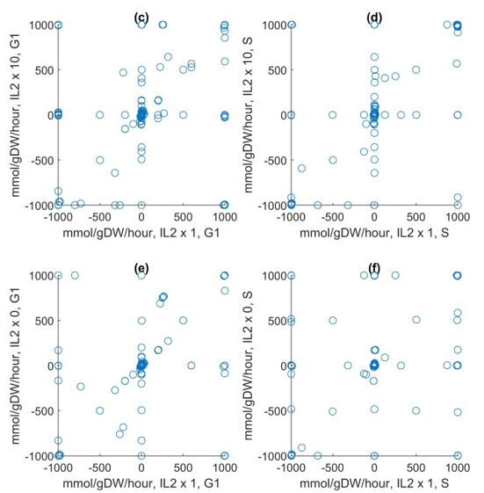
V2: IL2 dose-response study.
Peak responses at different IL2 concentrations.
Passed the three sets of activity levels to the Th0 metabolic model.
Optimised biomass synthesis for each set.
Comparison of optimised metabolic fluxes between sets.
Drastic, non-linear effects of IL2 on metabolism.
Effects of IL2 on metabolism:
Repeated the study at different IL2 concentrations.
Found the peak cell count in each case.
Dose-response study.

Slide 30
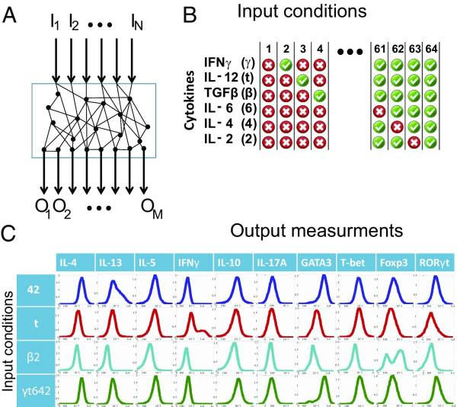
V3: phenotypic plasticity.
Experimental study:
Naïve CD4+ T cells from mouse spleens were cultured with antigenic signals and combinations of IL2, IL4, IL6, IL12, IFNg, and TGFb.
Expression levels of four transcription factors and six cytokines were quantified.
Phenotypic classification.
Results:
IL12, Th1.
IL2 and IL4, Th2.
TGFb and IL6, Th17.
TGFb and IL2, Treg.
Note that insufficient IL6 could lead to a mix of Th17 and Treg.
Gao, Zhimei, et al. "Synergy between IL-6 and TGF-β signaling promotes FOXP3 degradation." International journal of clinical and experimental pathology 5.7 (2012): 626.
Eizenberg-Magar, I., et al. (2017). Diverse continuum of CD4+ T-cell states is determined by hierarchical additive integration of cytokine signals. Proceedings of the National Academy of Sciences, 201615590.

Slide 31
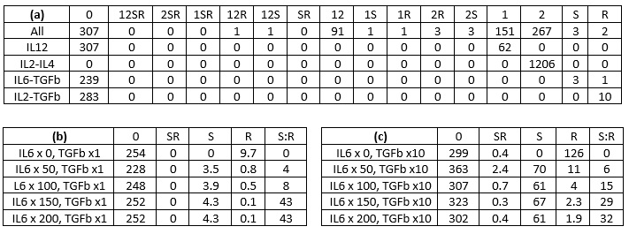
V3: phenotypic plasticity.
Peak responses for different cytokine combinations.
Nomenclature:
1 = Th1.
2 = Th2.
S = Th17.
R = Treg.
Experimental results:
IL12, Th1.
IL2 and IL4, Th2.
TGFb and IL6, Th17.
TGFb and IL2, Treg.
Note that insufficient IL6 could lead to a mix of Th17 and Treg.
Gao, Zhimei, et al. "Synergy between IL-6 and TGF-β signaling promotes FOXP3 degradation." International journal of clinical and experimental pathology 5.7 (2012): 626.

Slide 32
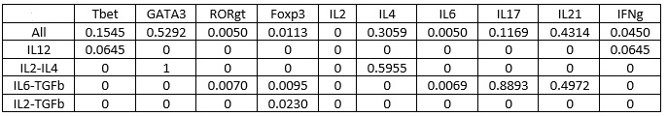
V3: phenotypic plasticity.
Peak responses for different cytokine combinations.
Decoupled the logical model from the other modules in the framework.
Estimated the attractors corresponding to different cytokine combinations (input nodes).
Experimental results:
IL12, Th1.
IL2 and IL4, Th2.
TGFb and IL6, Th17.
TGFb and IL2, Treg.
Note that insufficient IL6 could lead to a mix of Th17 and Treg.
Gao, Zhimei, et al. "Synergy between IL-6 and TGF-β signaling promotes FOXP3 degradation." International journal of clinical and experimental pathology 5.7 (2012): 626.

Slide 33
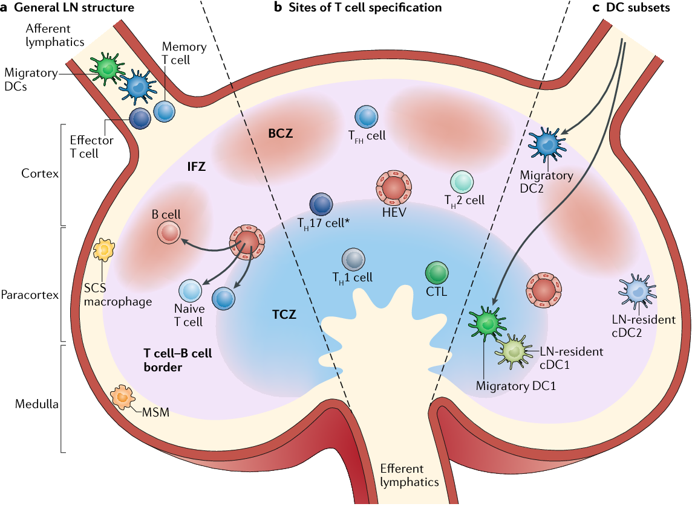
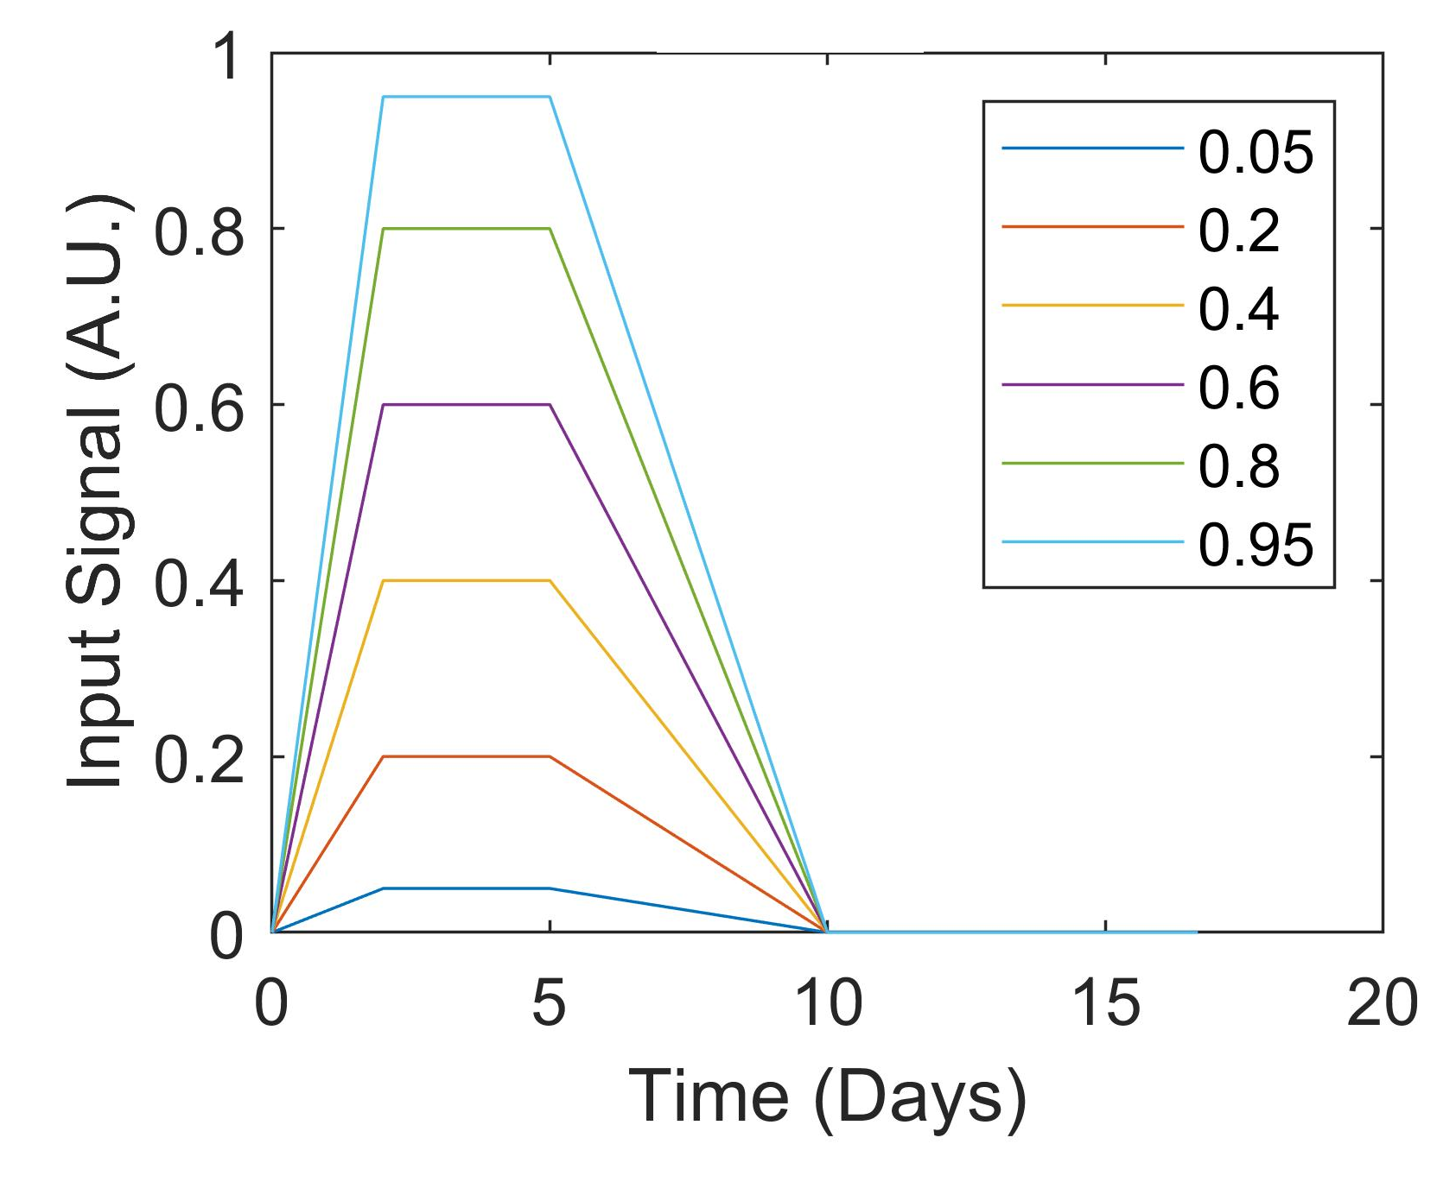
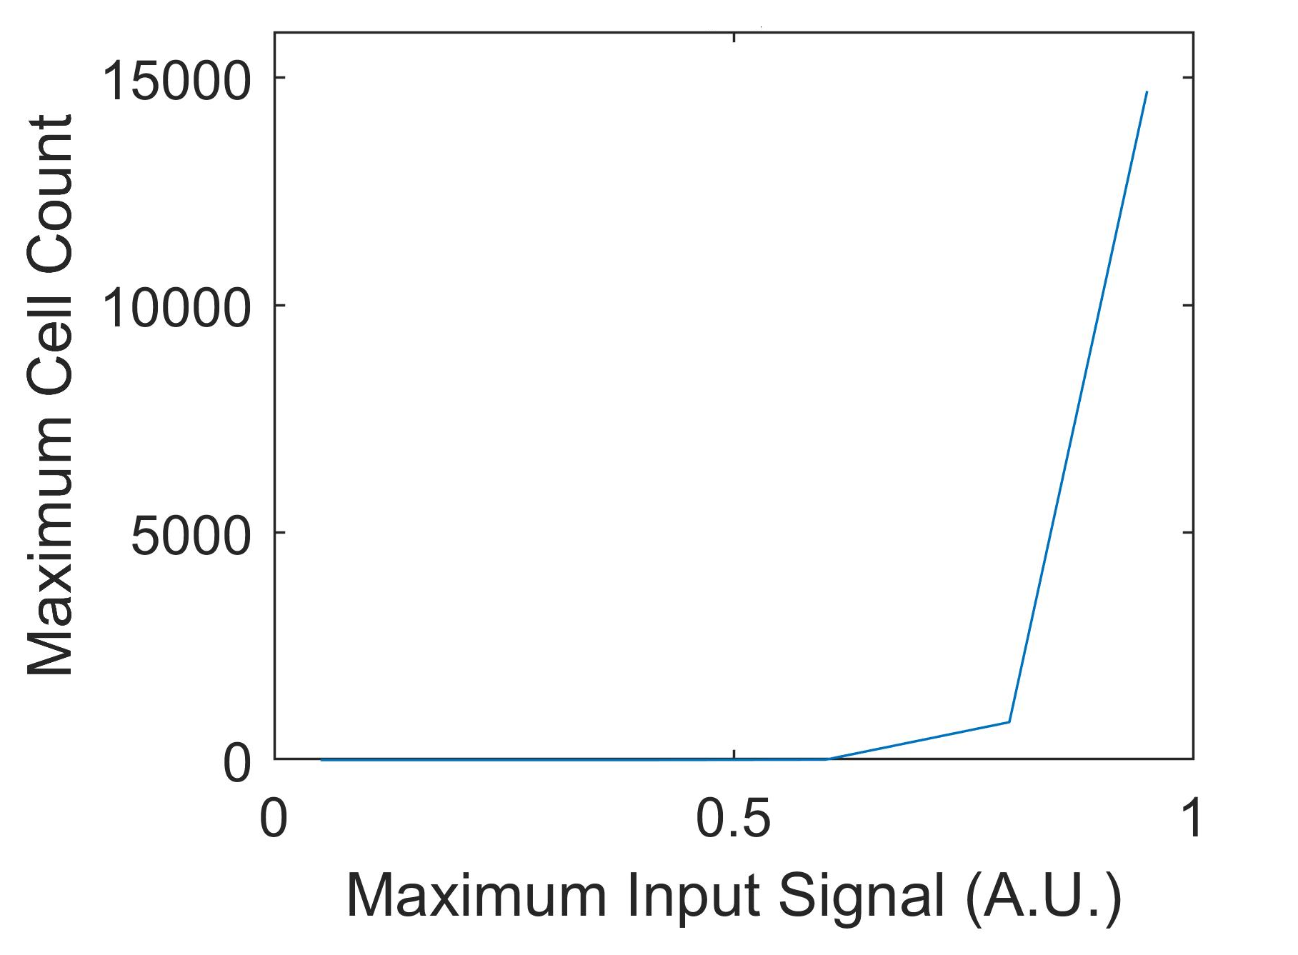
Novel switch-Like behaviour.
Eisenbarth, S. C. "Dendritic cell subsets in T cell programming: location dictates function." Nature Reviews Immunology 19.2 (2019): 89-103.
Inputs:
Modified the input signal.
Different peak strengths.
Outputs:
Found the peak CD4+ T cell response to each input signal.
Dose-response study.
Nothing below threshold.
Explanation:
Naïve CD4+ T cells must enter a lymph node to be activated.
Entry and retention depend on the input.

Slide 34
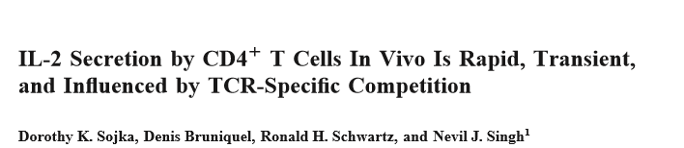
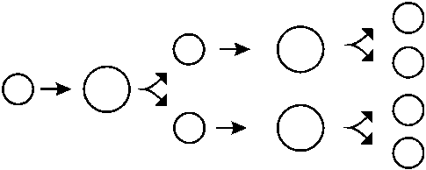
Novel switch-Like behaviour.
Explanation 1: Non-linear logical model amplifies the input.
Explanation 2: CD4+ T cells secrete IL2, i.e., positive feedback.
Inputs:
Modified the input signal.
Different peak strengths.
Outputs:
Found the peak CD4+ T cell response to each input signal.
Dose-response study.
Response rises exponentially above threshold.
Explanation 3: One effector cell gives rise to many more.

Slide 35
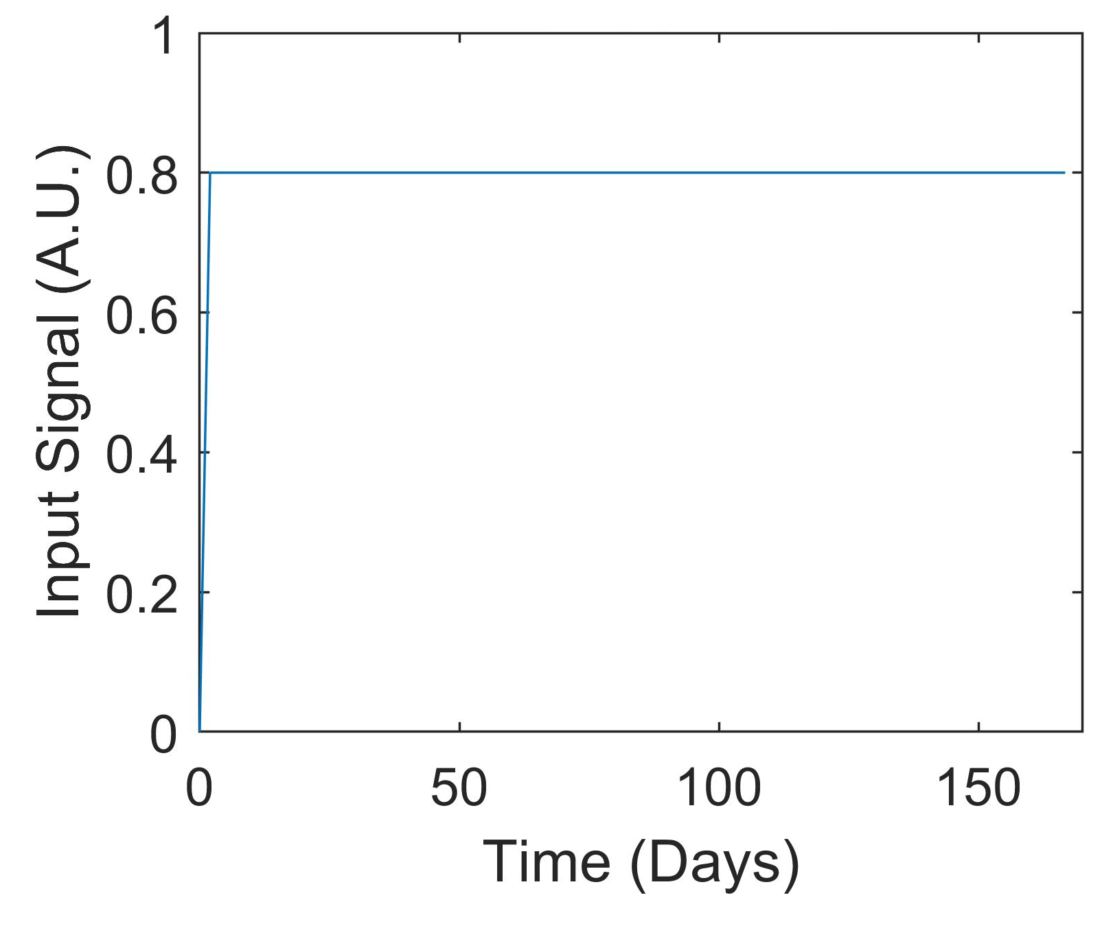
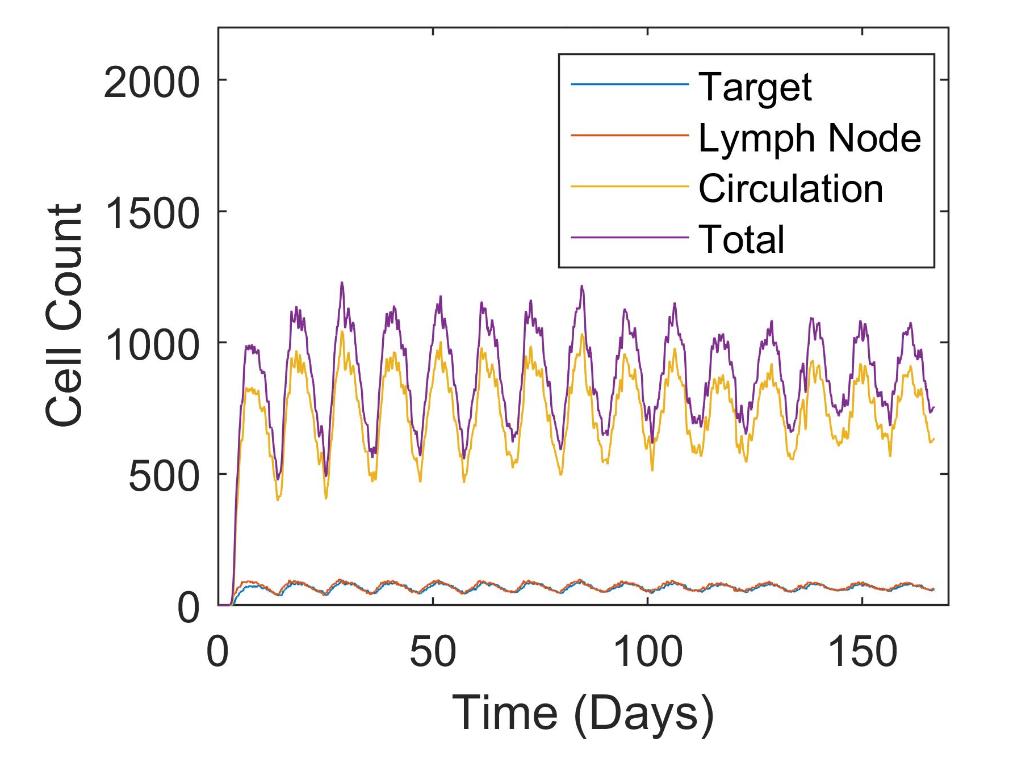
Novel oscillatory behaviour.
Inputs:
Modified the input signal.
Chronic instead of acute.
Outputs:
Sustained response expected.
Oscillatory response found.
Homeostasis, i.e., negative feedback.

Slide 36
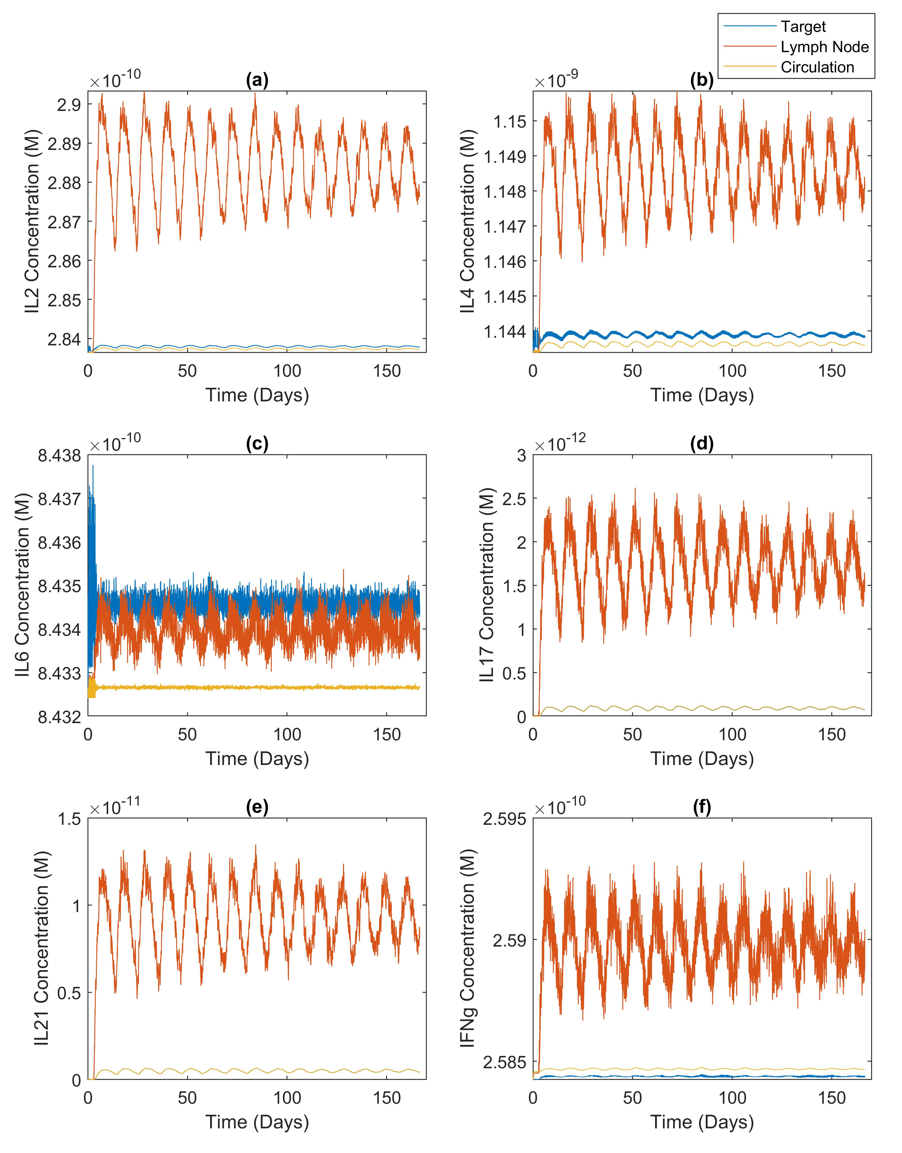
Novel oscillatory behaviour.
Inputs:
Modified the input signal.
Chronic instead of acute.
Outputs:
Different secretion rates.
Cytokine-secreting ability changes with cell migration.
Compartmental sizes.

Slide 37
Conclusion: unprecedented scope.
Multiple Layers of organisation, including cytokine signalling, cell population dynamics (life cycle), intracellular signal transduction, gene regulation, and metabolism.
Compartmental setup to support physiologically based pharmacokinetic and pharmacodynamic applications.
Systemic, cellular, and molecular events occurring at different time scales.

Slide 38
Conclusion: modularity.
Advantages:
Incorporation of new agent types.
Reusability of models within the framework or in isolation.
Different levels of granularity.
Caching modular simulation results.
Data integration.

Slide 39
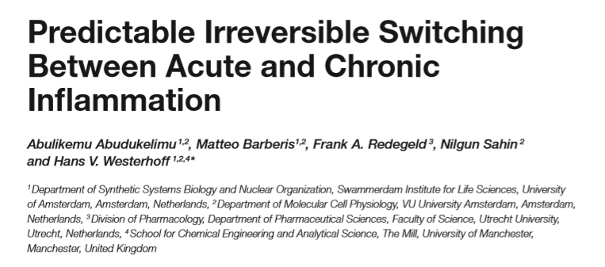
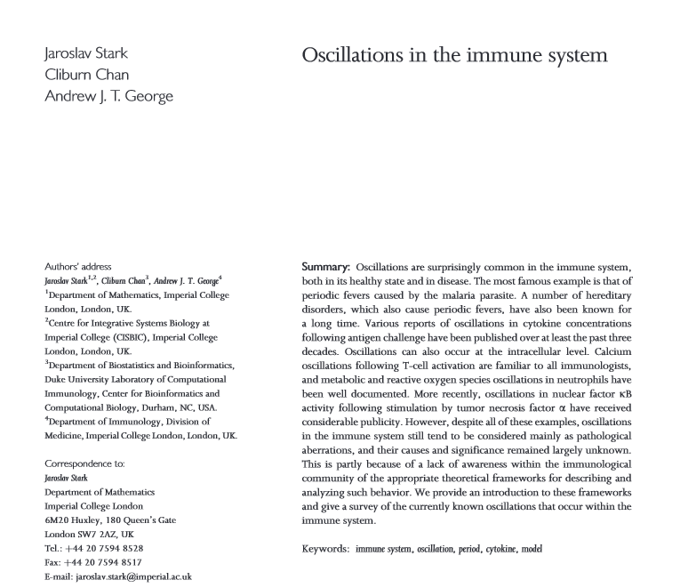
Conclusion: novel emergent behaviours.
Similar behaviours observed or predicted in relation to other immune cell types.
Switch-like behaviour could help the immune system filter out `noises’, i.e., small and non-threatening amount of antigen.
Oscillatory behaviour could prevent an immune response from getting out of control, i.e., cytokine storm.

Slide 40
Oncology

Slide 41

PRIMAGE.
Predictive in silico Multiscale Analytics to Support Cancer Personalised Diagnosis and Prognosis, Empowered by Imaging Biomarkers.
Objective:
Cloud-based decision-making platform for the clinical management of malignant solid tumours, specifically predictive tools for diagnosis, prognosis, therapeutic choices, and treatment follow-up.
Novel imaging biomarkers, in silico tumour growth simulation methods, advanced visualisation techniques, and machine learning tools.
Project facts:
10-million-euro Horizon 2020 project.
Financed by the European Commission.
16 partner institutions from eight European countries.

Slide 42
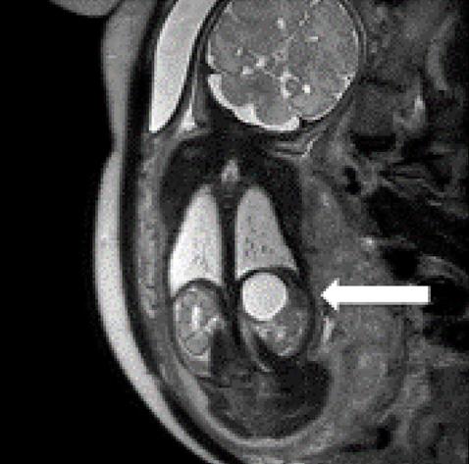
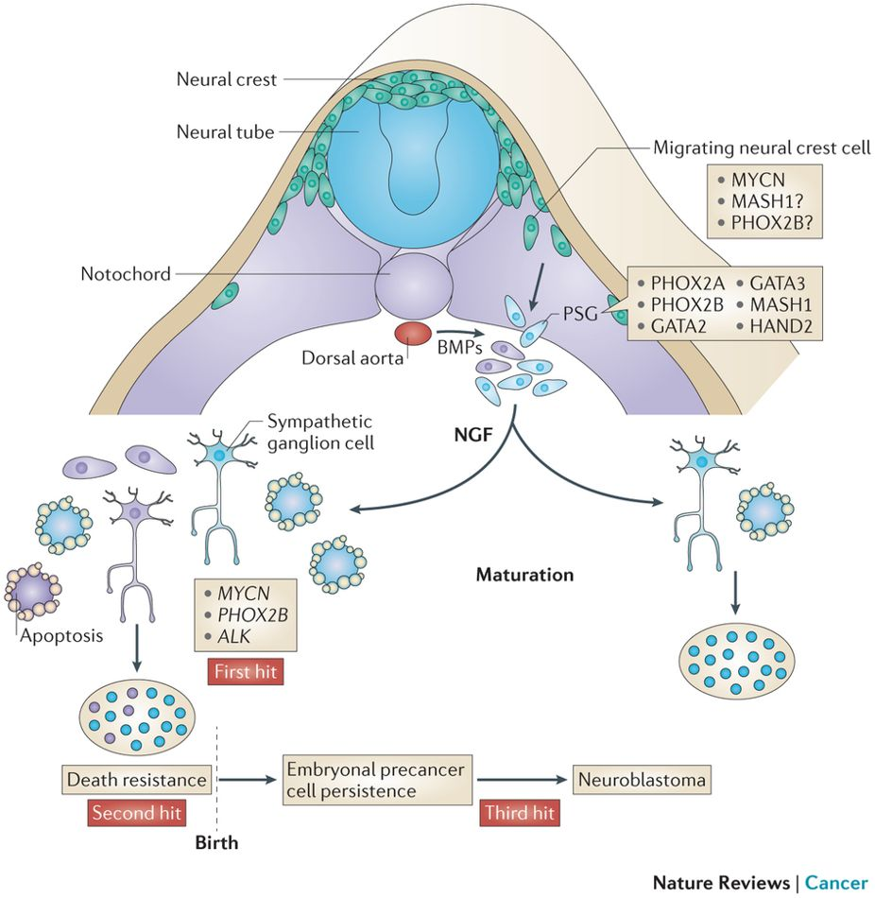
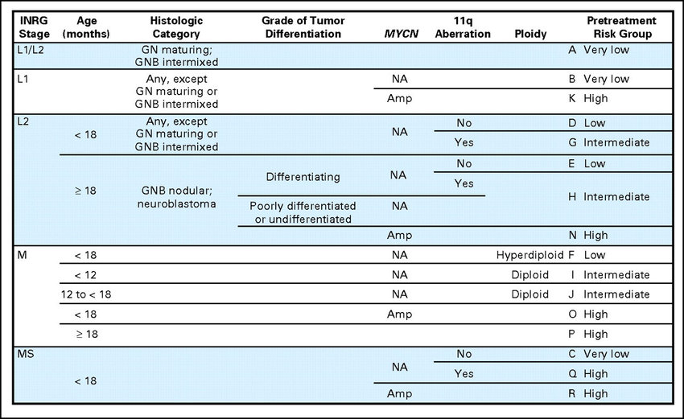
Neuroblastoma.
Louis, Chrystal U., and Jason M. Shohet. "Neuroblastoma: molecular pathogenesis and therapy." Annual review of medicine 66 (2015): 49-63.
Marshall, Glenn M., et al. "The prenatal origins of cancer." Nature Reviews Cancer 14.4 (2014): 277-289.
Sokol, Elizabeth, and Ami V. Desai. "The Evolution of Risk Classification for Neuroblastoma." Children 6.2 (2019): 27.
Paediatric cancer:
Most common extra-cranial solid tumour in children.
15 % of cancer-related deaths in children.
Adrenal medulla is usually the primary site.

Slide 43
Neuroblastoma.
Louis, Chrystal U., and Jason M. Shohet. "Neuroblastoma: molecular pathogenesis and therapy." Annual review of medicine 66 (2015): 49-63.
Marshall, Glenn M., et al. "The prenatal origins of cancer." Nature Reviews Cancer 14.4 (2014): 277-289.
Sokol, Elizabeth, and Ami V. Desai. "The Evolution of Risk Classification for Neuroblastoma." Children 6.2 (2019): 27.
Paediatric cancer:
Most common extra-cranial solid tumour in children.
15 % of cancer-related deaths in children.
Adrenal medulla is usually the primary site.
Neural crest:
Transient structure in the embryo.
Migrate and differentiate into a variety of different cell types.
Sympathetic nervous system.

Slide 44
Neuroblastoma.
Louis, Chrystal U., and Jason M. Shohet. "Neuroblastoma: molecular pathogenesis and therapy." Annual review of medicine 66 (2015): 49-63.
Marshall, Glenn M., et al. "The prenatal origins of cancer." Nature Reviews Cancer 14.4 (2014): 277-289.
Sokol, Elizabeth, and Ami V. Desai. "The Evolution of Risk Classification for Neuroblastoma." Children 6.2 (2019): 27.
Paediatric cancer:
Most common extra-cranial solid tumour in children.
15 % of cancer-related deaths in children.
Adrenal medulla is usually the primary site.
Neural crest:
Transient structure in the embryo.
Migrate and differentiate into a variety of different cell types.
Sympathetic nervous system.
Heterogeneity:
Spontaneous regression.
Drug resistance and metastasis even after multi-modal treatment.
MYCN amplification.

Slide 45
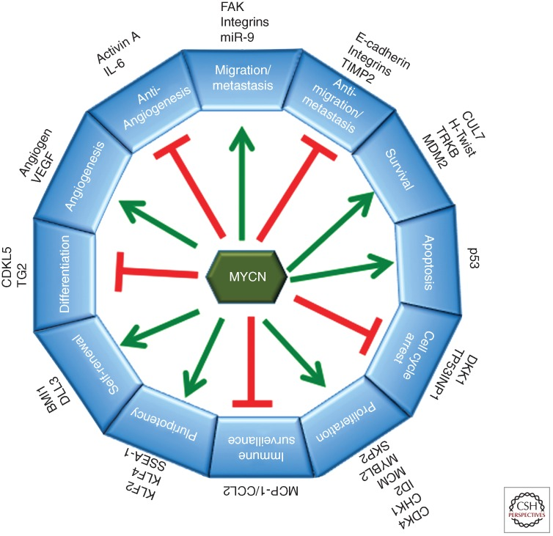
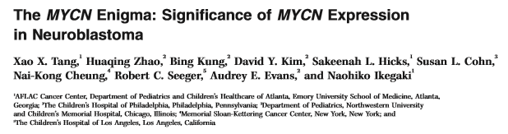
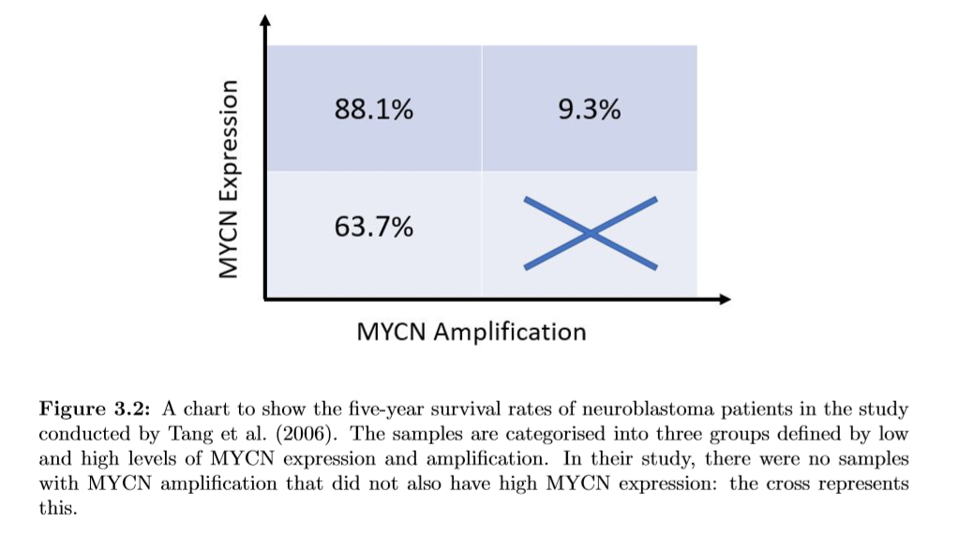
MYCN.
Huang, Miller, and William A. Weiss. "Neuroblastoma and MYCN." Cold Spring Harbor perspectives in medicine 3.10 (2013): a014415.
Oncogene:
Proliferation AND apoptosis.
Non-linear relation with disease outcome.

Slide 46
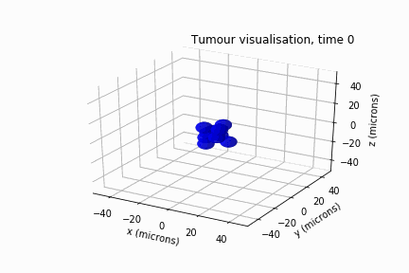
Centred-Based cell-based model.
A type of agent-based model.
Spatial effects are considered:
Off-lattice.
Three pillars:
Tumour growth.
Tumour regression.
Tumour-Microenvironment interactions.

Slide 47


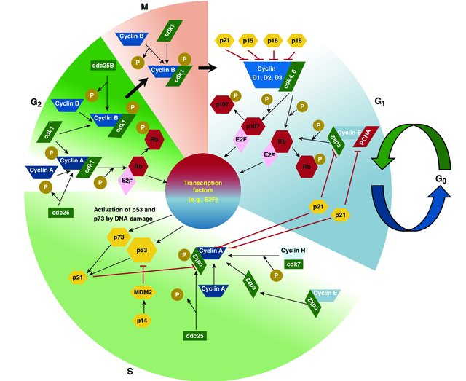
Tumour growth.
Attribute `cycle’:
Tracks an agent’s position in the cell cycle.
Probability of advancing in the cycle is determined by other agent attributes, e.g., p21.
G1:
MAPK/Ras signalling
p21
G2/M:
CDC25C
G0/G1:
MAPK/Ras signalling
p21
G1/S:
MAPK/Ras signalling
p21
S:
p21
Kaushansky, K., & Williams, W. J. (2016). Williams hematology. Modified.

Slide 48
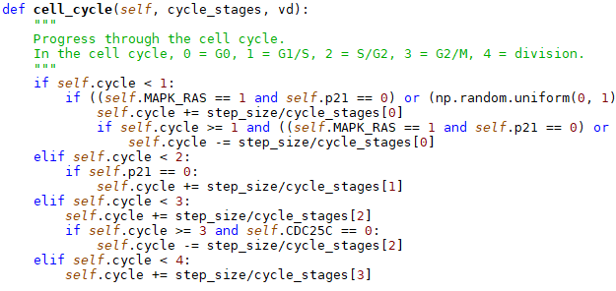
Tumour growth.
Attribute `cycle’:
Tracks an agent’s position in the cell cycle.
Probability of advancing in the cycle is determined by other agent attributes, e.g., p21.
G1:
MAPK/Ras signalling
p21
G2/M:
CDC25C
G0/G1:
MAPK/Ras signalling
p21
G1/S:
MAPK/Ras signalling
p21
S:
p21
Kaushansky, K., & Williams, W. J. (2016). Williams hematology. Modified.

Slide 49
Tumour growth.
MYCN:
Upregulates MAPK/Ras signalling.
Upregulates (via p53) and downregulates p21.
Downregulates CDC25C (via CHK1).
Independent positive effect on the G1 phase.
G1:
MAPK/Ras signalling
p21
G2/M:
CDC25C
or
MYCN
G0/G1:
MAPK/Ras signalling
p21
or
MYCN
G1/S:
MAPK/Ras signalling
p21
S:
p21
or
MYCN
Kaushansky, K., & Williams, W. J. (2016). Williams hematology. Modified.

Slide 50
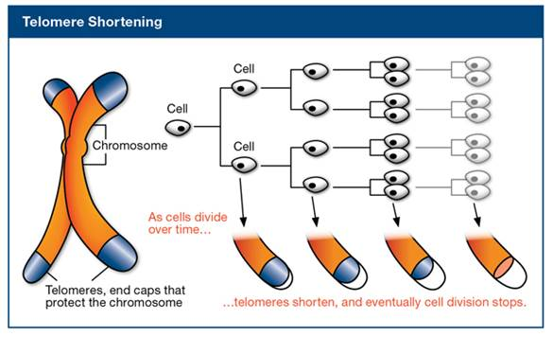

Tumour regression.
Hypoxia-induced necrosis:
Prolonged process taking up to around one week.
Saturation kinetics.
$P_{necrosis}$ = 1 - $\frac{\left[O_{2}\right]}{\left[O_{2}\right]+{\left[O_{2}\right]}_{50}}$
http://sphweb.bumc.bu.edu/otlt/mph-modules/ph/aging/aging3.html
Cell division shortens telomeres, causing DNA damages:
p53 signalling.
CHK1 and p73 signalling.
Arrest cell cycle by upregulating p21 and downregulating CDC25C.
Promote apoptosis (two to three hours).

Slide 51
Tumour regression.
Hypoxia-induced necrosis:
Prolonged process taking up to around one week.
Saturation kinetics.
$P_{necrosis}$ = 1 - $\frac{\left[O_{2}\right]}{\left[O_{2}\right]+{\left[O_{2}\right]}_{50}}$
http://sphweb.bumc.bu.edu/otlt/mph-modules/ph/aging/aging3.html
Cell division shortens telomeres, causing DNA damages:
p53 signalling.
CHK1 and p73 signalling.
Arrest cell cycle by upregulating p21 and downregulating CDC25C.
Promote apoptosis (two to three hours).

Slide 52
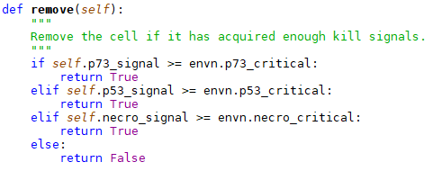
Tumour regression.
Hypoxia-induced necrosis:
Prolonged process taking up to around one week.
Saturation kinetics.
$P_{necrosis}$ = 1 - $\frac{\left[O_{2}\right]}{\left[O_{2}\right]+{\left[O_{2}\right]}_{50}}$
Three parallel processes, two time scales, different thresholds.
http://sphweb.bumc.bu.edu/otlt/mph-modules/ph/aging/aging3.html
Cell division shortens telomeres, causing DNA damages:
p53 signalling.
CHK1 and p73 signalling.
Arrest cell cycle by upregulating p21 and downregulating CDC25C.
Promote apoptosis (two to three hours).

Slide 53
Tumour regression.
Hypoxia-induced necrosis:
Prolonged process taking up to around one week.
Saturation kinetics.
$P_{necrosis}$ = 1 - $\frac{\left[O_{2}\right]}{\left[O_{2}\right]+{\left[O_{2}\right]}_{50}}$
Three parallel processes, two time scales, different thresholds.
http://sphweb.bumc.bu.edu/otlt/mph-modules/ph/aging/aging3.html
MYCN kills and heals:
MYCN’s effects on p53 are controversial.
MYCN upregulates CHK1 and p73.
MYCN can activate telomerase to repair DNA damages.

Slide 54






Tumour-Microenvironment interactions.
1. Intercellular mechanical forces.
Step 1:
Repulsive forces due to overlap.
2. γ is resistance from the stroma:
Stromal density (cells and matrix).
Neuroblasts’ ability to degrade the matrix.
Neuroblasts’ tendency to detach from it.
3. Neuroblasts consume oxygen:
Constant oxygen supply.
Active vascularisation not modelled.
Step 2:
Adhesive forces due to E-cadherin.
Step 3:
Overdamped Newton’s second law.

Slide 55
Tumour-Microenvironment interactions.
1. Intercellular mechanical forces.
Step 1:
Repulsive forces due to overlap.
Literature and images.
2. γ is resistance from the stroma:
Stromal density (cells and matrix).
Neuroblasts’ ability to degrade the matrix.
Neuroblasts’ tendency to detach from it.
3. Neuroblasts consume oxygen:
Constant oxygen supply.
Active vascularisation not modelled.
Step 2:
Adhesive forces due to E-cadherin.
Step 3:
Overdamped Newton’s second law.

Slide 56
Tumour-Microenvironment interactions.
1. Intercellular mechanical forces.
Step 1:
Repulsive forces due to overlap.
MYCN correlates with a high degrading ability.
2. γ is resistance from the stroma:
Stromal density (cells and matrix).
Neuroblasts’ ability to degrade the matrix.
Neuroblasts’ tendency to detach from it.
MYCN downregulates E-cadherin.
MYCN correlates with a high tendency to detach.
p53 correlates with a low tendency to detach.
3. Neuroblasts consume oxygen:
Constant oxygen supply.
Active vascularisation not modelled.
Step 2:
Adhesive forces due to E-cadherin.
MYCN correlates with a high level of vascularisation.
Step 3:
Overdamped Newton’s second law.

Slide 57
State transition and parameterisation.
Is MAPK/Ras signalling on at this time step?
Bernoulli trial.

Slide 58
State transition and parameterisation.
Is MAPK/Ras signalling on at this time step?
Bernoulli trial.
Upregulation by MYCN.

Slide 59
State transition and parameterisation.
Is MAPK/Ras signalling on at this time step?
Bernoulli trial.
Upregulation by MYCN.
Mutations unrelated to MYCN.

Slide 60
State transition and parameterisation.
Is MAPK/Ras signalling on at this time step?
Bernoulli trial.
Upregulation by MYCN.
Mutations unrelated to MYCN.
Is p21 active at this time step?
MYCN could have a bigger or smaller effect on p21.
That is the parameterisation process.

Slide 61
State transition and parameterisation.
Simulation time!
Initial conditions:
100 neuroblast agents.
1 % of the oxygen level of a healthy kidney.
Parameters:
No oxygen supply.
All MYCN effects are parameterised identically.
No other mutations.
Single clone.
Is MAPK/Ras signalling on at this time step?
Bernoulli trial.
Upregulation by MYCN.
Mutations unrelated to MYCN.
Is p21 active at this time step?
MYCN could have a bigger or smaller effect on p21.
That is the parameterisation process.

Slide 62



Parallel computing using FLAMEGPU.
High performance agent-based simulation:
Abstraction of GPU programming (CUDA) away from modelling user.
Individual agents (e.g. cells) are mapped to highly parallel architecture of GPU.
Applications in many domains.
One time step involving millions of neuroblast agents, computing time is ~1 minute.

Slide 63





Neuroblastoma progression is emergent.
Counter-intuitive behaviour:
MYCN affects cell cycling, apoptosis, and tumour-microenvironment interactions in contradictory ways.
Population dynamics emerge from the interactions between these components.
Sensitive dependence on MYCN’s relative contributions to different components.
Not vascularised sufficiently.

Slide 64
Conclusions.
Early stage of the project:
Results are preliminary but promising.
One point in the parametric space, one counter-intuitive trend.
Future work:
Enrich microenvironment by adding fibroblasts for matrix remodelling, endothelial cells for vascularisation, and immune cells.
Calibrate the model by parameterising it to fit experimental data.
Couple it to intracellular model (ChemoTargets) and continuous model at the same multicellular/tissue scale (UNIZAR).
Develop a pipeline to parameterise the model from genomic data (all cancer types).

Slide 65
Cancer Immunotherapy

Slide 66
Vision.
Observations:
Cancer develops drug resistance in an evolutionary process.
Immunotherapy is the great new hope.
Immunosuppressive tumour microenvironment.
Evolutionary game theory:
Combine my two modelling frameworks.
Model competition between tumour cells and stromal cells.
Drugs alter the fitness landscape and evolutionary pathways.
Optimise immunotherapies by minimising resistance.

Slide 67





Immunology project acknowledgements.
Dr Tomas Helikar, principal investigator.
Dr Matteo Barberis, collaborator.
Dr Bhanwar Lal Puniya, colleague.
Dr Ab Rauf Shah, colleague.
Ms Alyssa La Fleur, summer intern.

Slide 68


Oncology project acknowledgements.
Dr Dawn Walker, principal investigator.
Dr Paul Richmond, collaborator.
Dr Robert Chisholm, colleague and research software engineer.
Ms Melody Parker, MSc student.
Other participants of PRIMAGE.

